Slide 1
Introduction

Slide 2
Consultant Journey
Maven
Eclipse
MySQL on GCP
Junit
Mockito
Progress Tracking

Slide 3
CI
GitHub
Different Feature Branches
-Customer
-Item
-Order
-Dev
-Started with, a commit per class
-Later changed, slight regret

Slide 4
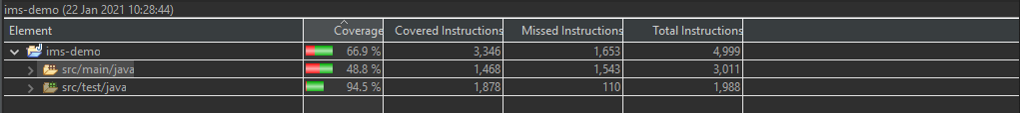
Testing
Test Driven Development
Testing done first before moving onto next feature
Progress Tracking

Slide 5
Demonstration

Slide 6

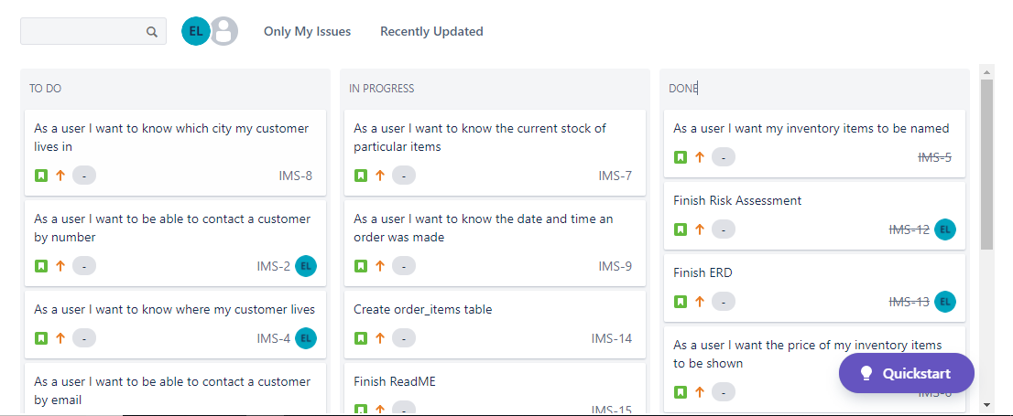




Sprint Review

Slide 7

Sprint Retrospective
Read Requirements more Before Writing User Stories
Split into clear sections
Learn how to do X must be finished before Y

Slide 8
Conclusion
Started Well
Broke down towards the end
Less confidence and towardness
Speak to group and training members more
Take more advantage of trainers even if confident
Think of better questions and flaws to process
Think and ask for ways to approach parts not done yet
Could have been a lot better
Faith it will be better
Make this personal project and way to monitor growth

Slide 9

Questions

